Slide 1




Slide 2
Fire Fighting Robot
Autonomous

Slide 3
INTRODUCTION
In real life many fire accidents can happen at anytime and anywhere. They become uncontrollable, causing collateral damages and life losses. Apart from fire, dangerous smokes inhalation also lead to severe injuries and death in some cases. Our project addresses this issue by creating a Sustainable fire respondent which will be capable of dealing with fire accidents with minimum human involvement.

Slide 4





TEAM ALPHA
Muhammad Yaseen Student (EE)
Asif Rasool Student (CS)
Usama Zafar Student (CS)
Iqbal Khatoon Student (SE)
Huma Jamil Student (Maths)

Slide 5
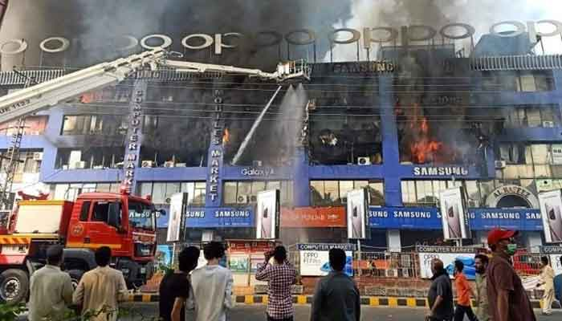
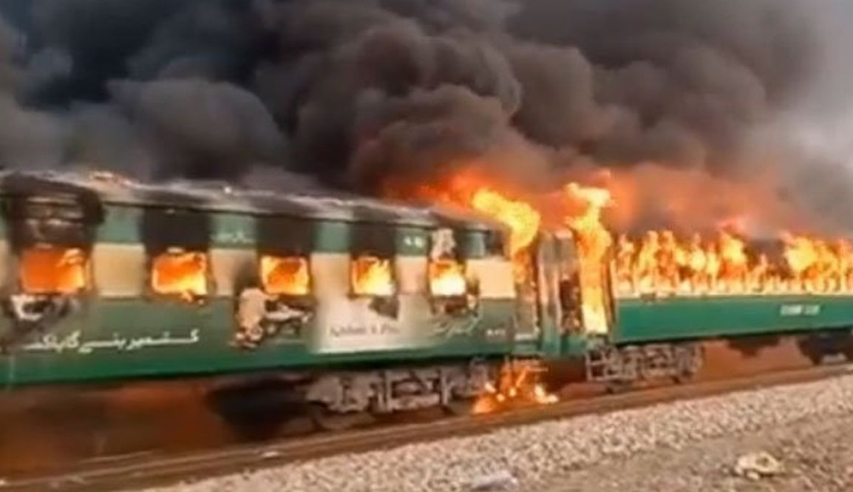

Slide 6



CASE STUDY-1: Massive Fire At Lahore’s Commercial Center
Damage Caused
Rescue Efforts
Cause
40% shops burnt to ground
Millions rupee loss to shopkeepers
Fire was reported 4 hours late
Extinguishing matured fire took 2 days
Short Circuit on a floor

Slide 7

CASE STUDY-11: Fire Brokeout in Moving Train
Damage Caused
Rescue Efforts
Cause
46 Life losses
3 Train Carriages Destroyed
Fire increased because of moving Train
Fire Tenders were unable to catch
Small Cylinder Blast

Slide 8
Analysis of Fire Incidents in Pakistan
Statistics
Affected Places
~3 incidents everyday
Commercial Buildings
Residential Buildings
1 out of 8 incidents takes lives
Causes
Short Circuiting
Gas Leakage
Cylinder Blasts
Fire design cost is as low as 3%

Slide 9
PROBLEM SUMMARY
Human can’t deal with fire incidents 24/7 with zero daly time. Also, sometimes fire occurs in the places where firefighters can’t reach due to the danger of infrastructure collision.

Slide 10

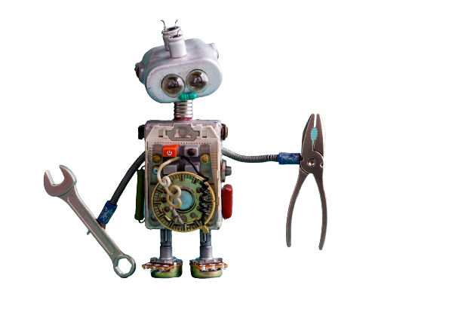
Proposed Solution
We are creating FireFighting Robot which will detect any fire occurring in its surrounding, sending the alarm signal to the device controlling the robot. The robot will be controlled through mobile application.The user can then instruct the robot to start extinguishing process till the main rescue team reaches.

Slide 11
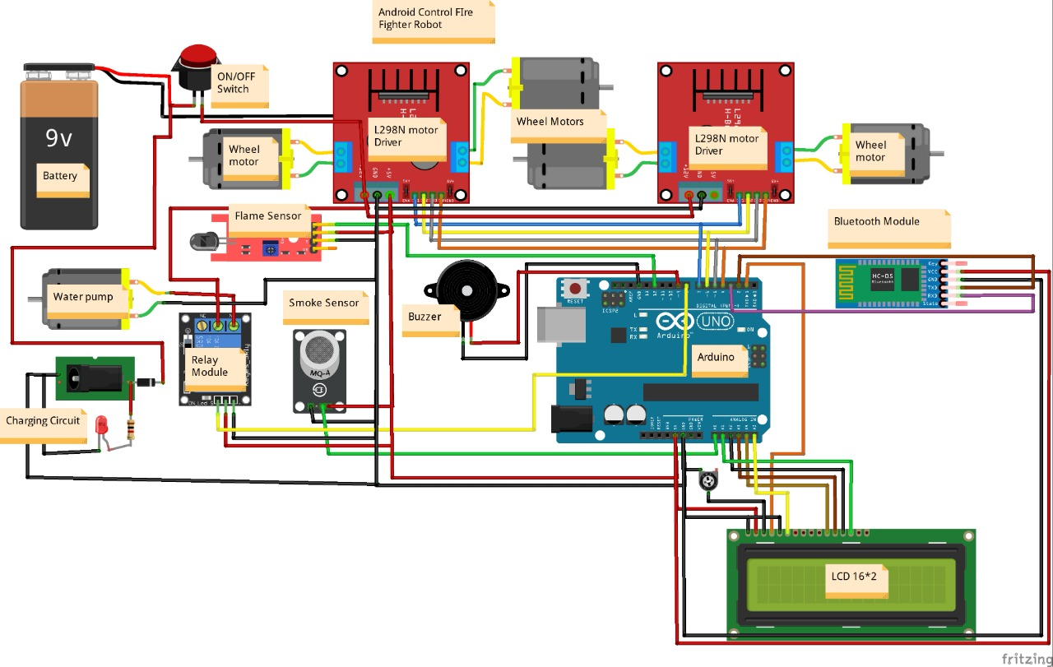

Slide 12
Main Features
S
W
B
C
Smoke Sensor
Water Capacity
Bluetooth Control
Cost Effective
The Robots sends alarm when the sensor detects smoke
Our Prototype supports ~3 - 5 litres of water tank
The device will control the robot using bluetooth signals
The estimated cost to build this robot is ~$250 - $300

Slide 13
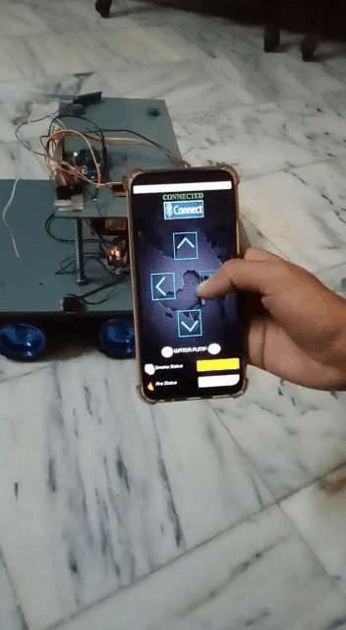
Prototype
Initial Concept
Mobile Application
Will make it fully Autonomous
Currently in Progress

Slide 14

Main Application Areas
Server Rooms
LPG stores
Chemical Laboratories
Record Maintaining
rooms

Slide 15
EFFECTIVENESS
First Response to Fire
May Extinguish fire itself
Can Control the fire before FireFighters arrive
Minimize the loss
Minimum Human Involvement (0 in future)
Fully Autonomous in near future.
Climate Change
Cost Effective

Slide 16
Different from Existing Technologies
Carbon Cylender
Sand Buckets
Water Sprinklers

Slide 17

Future Work
The operating range can be improved via wifi connectivity
The robot would be able to detect obstacles in its way
The robot would be able to work automatically
WiFi connectivity
Stereo Visión
Autonomous

Slide 18
What We’ll Get?
Saving Lives of Millions
+

Slide 19
THANKS
Organizers, Mentors and all participants.

